Slide 1

PRIME NUMBERS
Programming Club, AKGEC

Slide 2
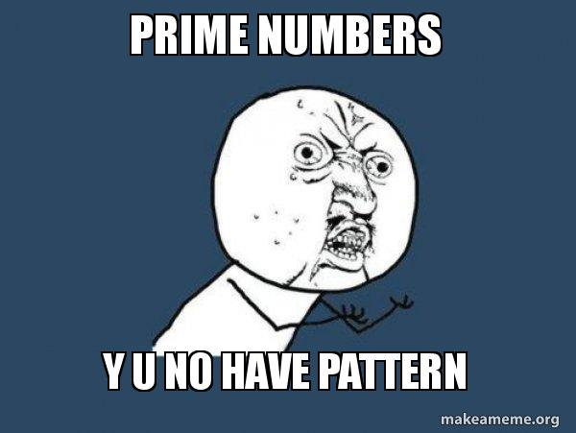
What are Prime Numbers?
Prime numbers are numbers greater than 1. They only have two factors, 1 and the number itself. This means these numbers cannot be divided by any number other than 1 and the number itself without leaving a remainder.
For example : - 2,3,5,7,11,13…………….
Programming Club, AKGEC

Slide 3
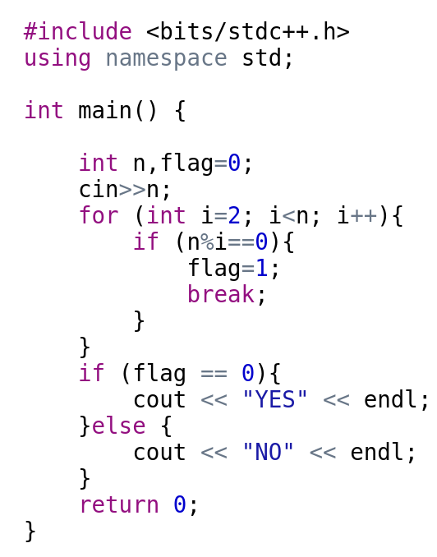
Check the Number is Prime or not
Example :
Number: : Factors
23 | 1 | 23
12 | 1 | 2 | 3 | 4 | 6 | 12
Programming Club, AKGEC

Slide 4
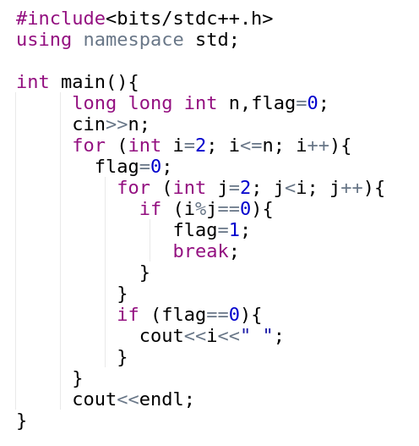
Finding Prime Numbers Up to n terms
Time complexity analysis
O((n*(n-1))/2) ≅ O(n²)
Example:-
Input: -
10
Output: -
2 3 5 7
Input :-
33
Output:-
2 3 5 7 11 13 17 19 23 29 31
Programming Club, AKGEC

Slide 5
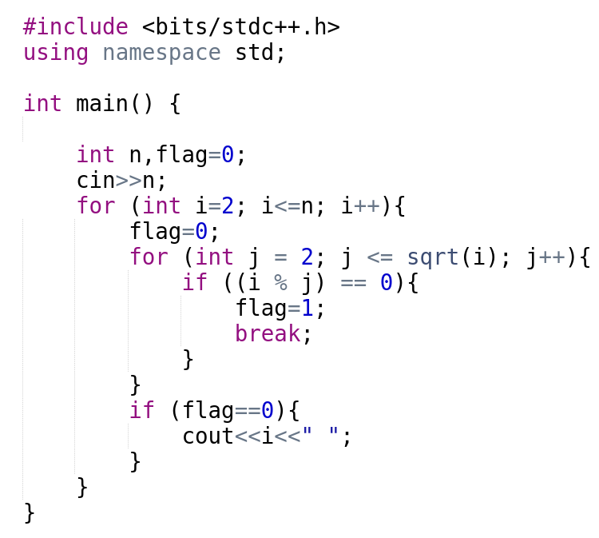
Time complexity analysis
O(n*(sqrt(n))
Example: -
Input: -
15
Output: -
2 3 5 7 11 13
Input :-
33
Output:-
2 3 5 7 11 13 17 19 23 29 31
Programming Club, AKGEC

Slide 6
Sieve of Eratosthenes
Sieve of Eratosthenes is an algorithm for finding all the prime numbers in a segment [1:n] using O(nlog⁡log⁡n) operations.The algorithm is very simple: at the beginning we write down all numbers between 2 and n. We mark all proper multiples of 2 (since 2 is the smallest prime number) as composite. A proper multiple of a number x is a number greater than x and divisible by x.
Then we find the next number that hasn't been marked as composite, in this case it is 3. Which means 3 is prime, and we mark all proper multiples of 3 as composite. The next unmarked number is 5, which is the next prime number, and we mark all proper multiples of it. And we continue this procedure until we processed all numbers in the row.
0 1 2 ………………………………………………… n
prime[n+1] | 0 | 0 | 1 | …. | …. | …. | …. | … | 1
Programming Club, AKGEC

Slide 7
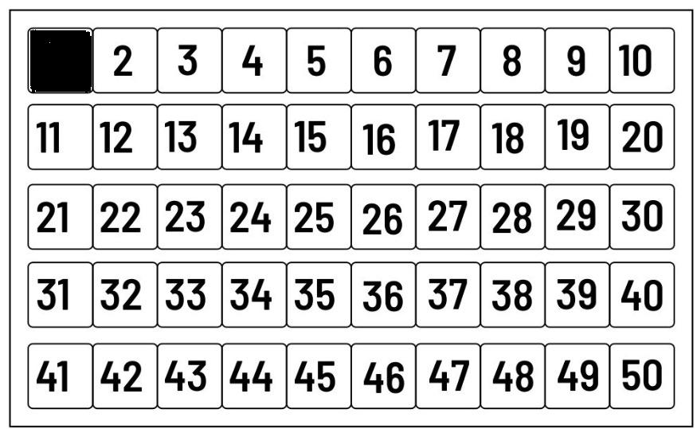
Table that helps to see a visualization of the algorithm for computing all prime numbers in the range
Programming Club, AKGEC

Slide 8
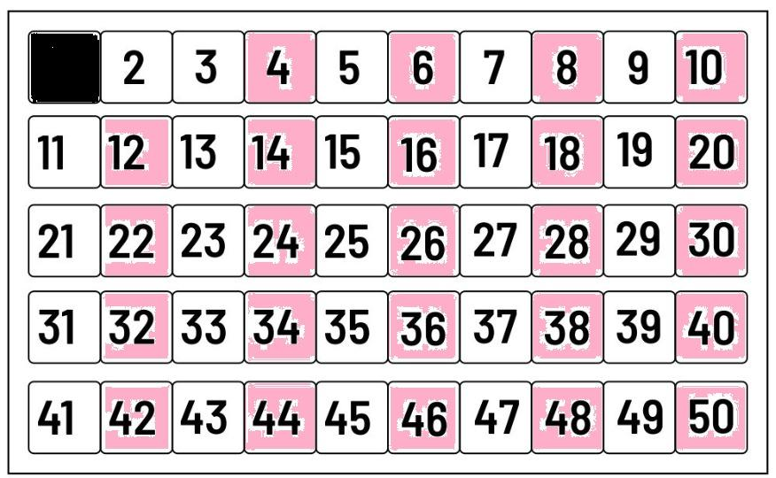
Removing All multiples of 2:-
Programming Club, AKGEC

Slide 9
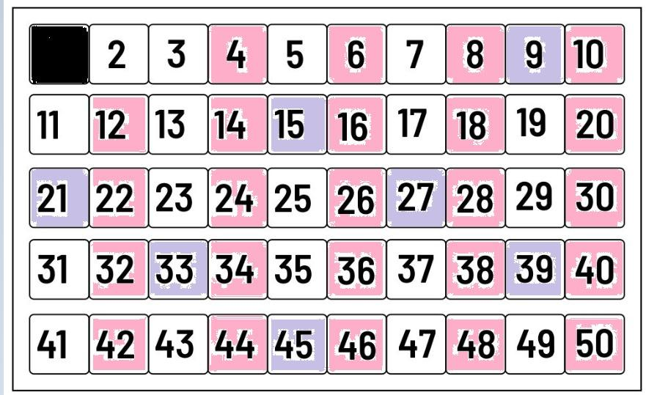
Removing All multiples of 3: -
Programming Club, AKGEC

Slide 10
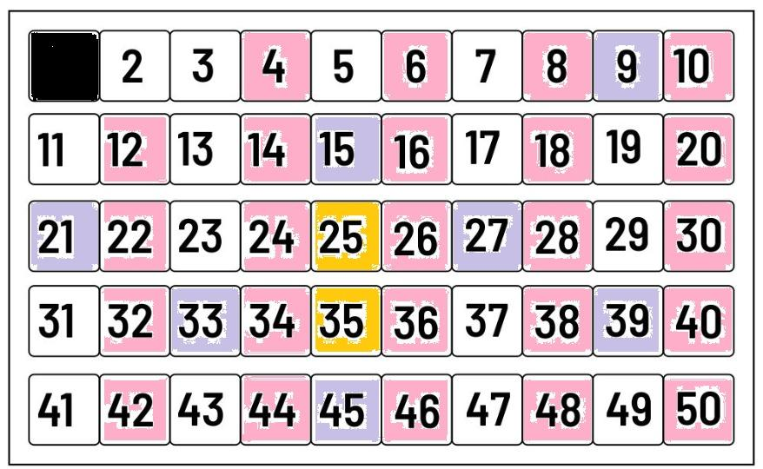
Removing all multiples of 5: -
Programming Club, AKGEC

Slide 11
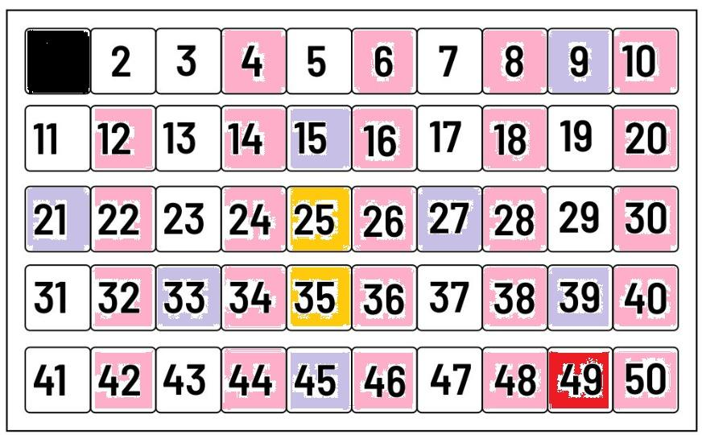
Removing all multiples of 7: -
Programming Club, AKGEC

Slide 12
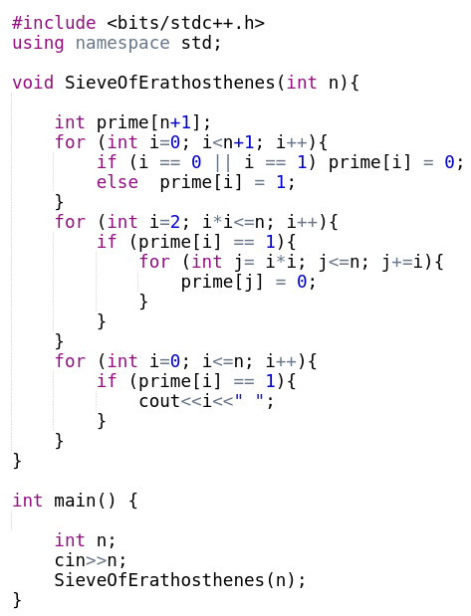
Program of Sieve Of Eratosthenes
Example: -
Input: -
10
Output: -
2 3 5 7
Input :-
33
Output:-
2 3 5 7 11 13 17 19 23 29 31
Time Complexity: - O(nloglog(n))
Programming Club, AKGEC

Slide 13
Calculating Factors of a
Number
Programming Club, AKGEC

Slide 14
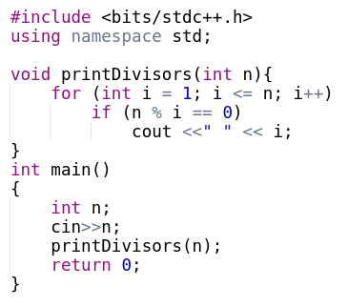
Bruteforce code
Example: -
Input: -
10
Output: -
1 2 5 10
Input :-
33
Output:-
1 3 11 33
Programming Club, AKGEC

Slide 15
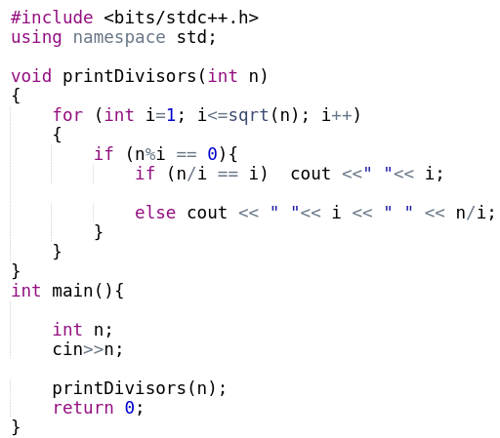
Example: -
Input: -
10
Output: -
1 2 5 10
Input :-
33
Output:-
1 3 11 33
Programming Club, AKGEC

Slide 16
Calculating Prime Factors of a Number
Programming Club, AKGEC

Slide 17
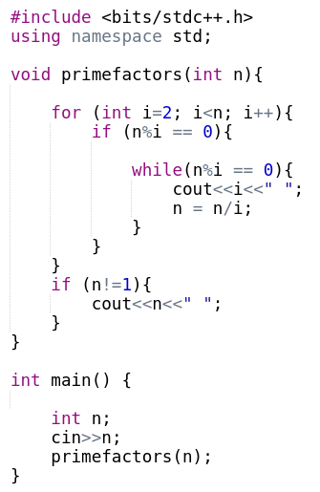
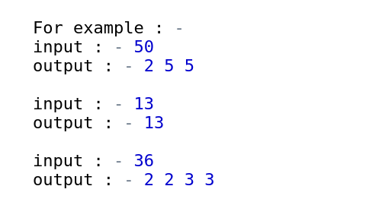
BruteForce code of Calculating Prime Factors
Time Complexity:- O(n)
Programming Club, AKGEC

Slide 18
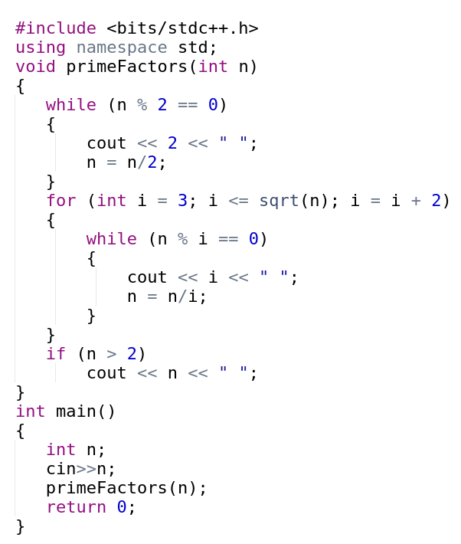
Calculating Prime Factors in O(sqrt(n))
Programming Club, AKGEC

Slide 19
Goldbach’s Conjecture
Programming Club, AKGEC

Slide 20
The Goldbach's conjecture, one of the oldest and best-known unsolved problems in mathematics, states that every even natural number greater than 2 is the sum of two prime numbers.
The conjecture has been tested up to 4 × 10¹⁸
for example:-
10 = 3 + 7
222 = 11 + 211
50 = 3 + 47
Programming Club, AKGEC

Slide 21
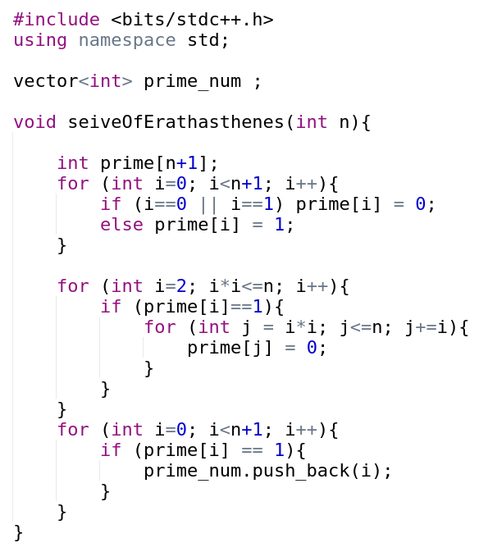
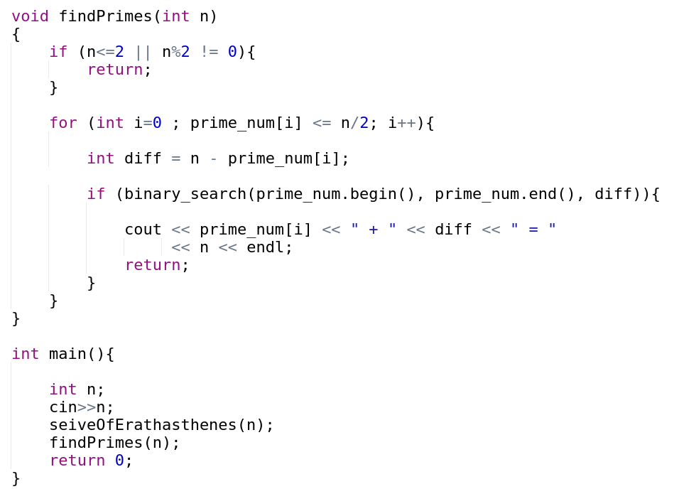
Programming Club, AKGEC

Slide 22
Problems:---
http://codeforces.com/contest/26/problem/A
https://codeforces.com/problemset/gymProblem/102267/B#:~:text=A%20prime%20number%20is%20a,%E2%89%A4n%E2%89%A4107).

Slide 23
Thank You
Programming Club, AKGEC

